Slide 1
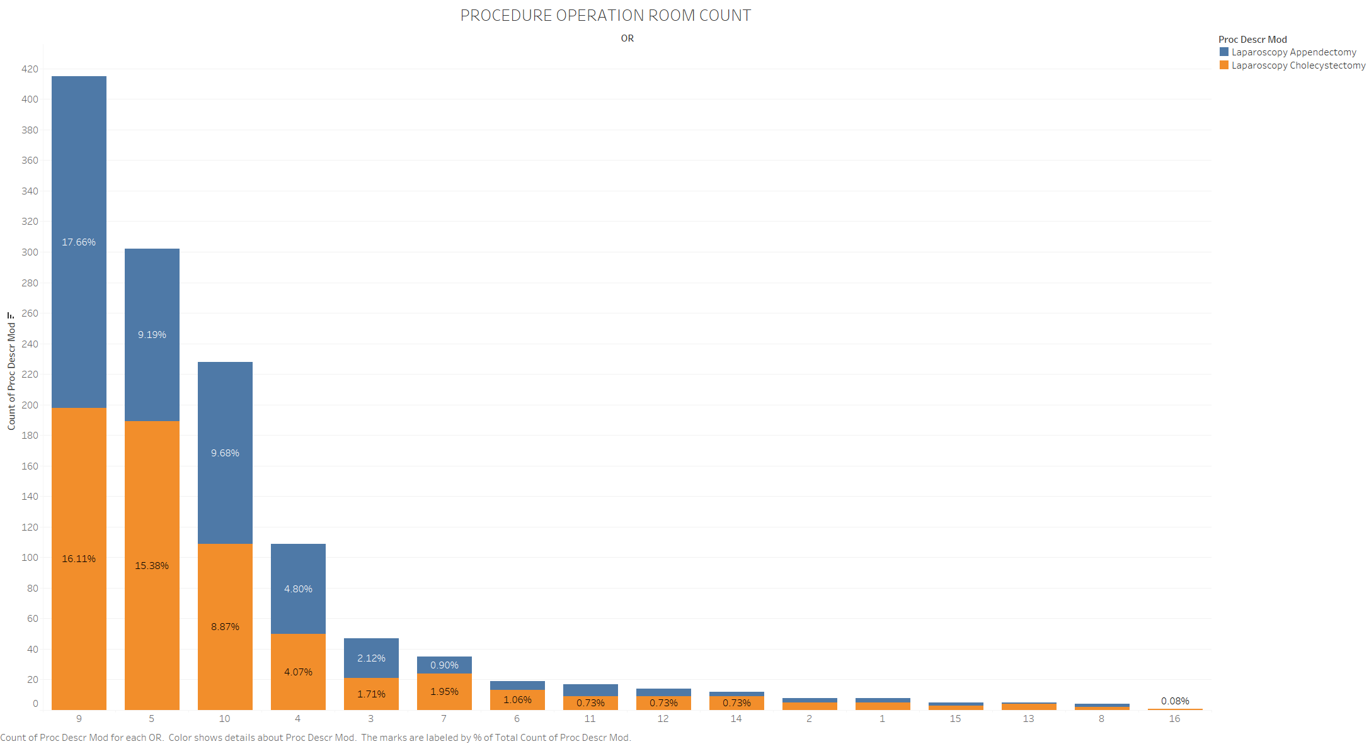
A substantial number of these two procedures is carried out in patient operating rooms 9,5,10, & 4. There are 12 other operating rooms where patients could possibly be booked for operation. Easing the concentration on these 4 operating rooms could help alleviate procedure delays.

Slide 2
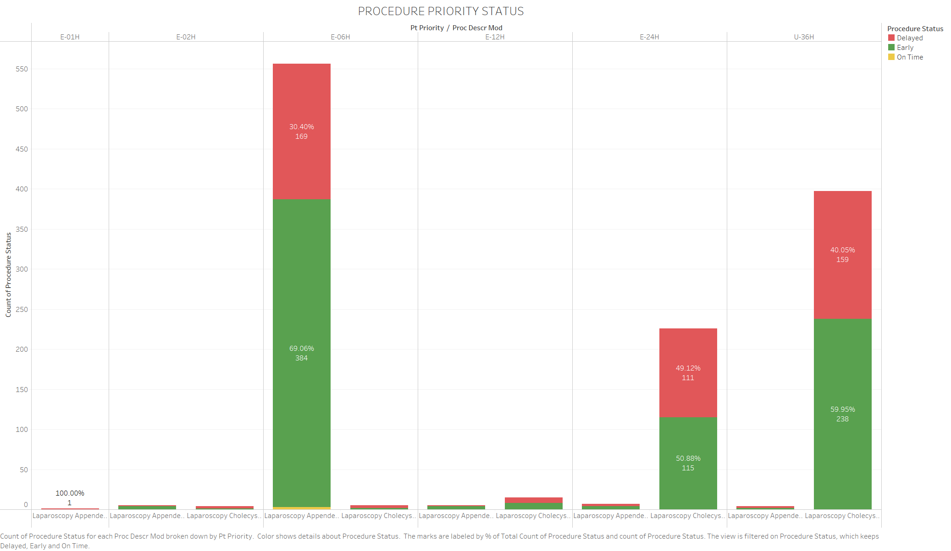
30.4% (169 patients) of scheduled patients with priority E-06H had their procedures delayed for Laparoscopy Appendectomy.
49.12% (111 patients) with priority E-24H and 40.5% (159) with priority E-36H scheduled for Laparoscopy Cholecystectomy had their procedures delayed.
Only on-time procedure was Laparoscopy Appendectomy for three patients with priority level E-06H.

Slide 3
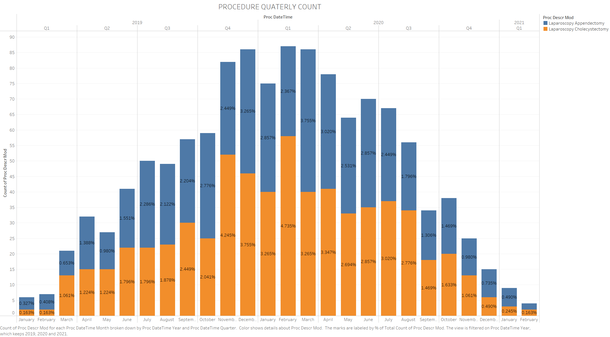
The surge in number of these procedures occurred in the last quarter of 2019 into the third quarter of 2020.

Slide 4
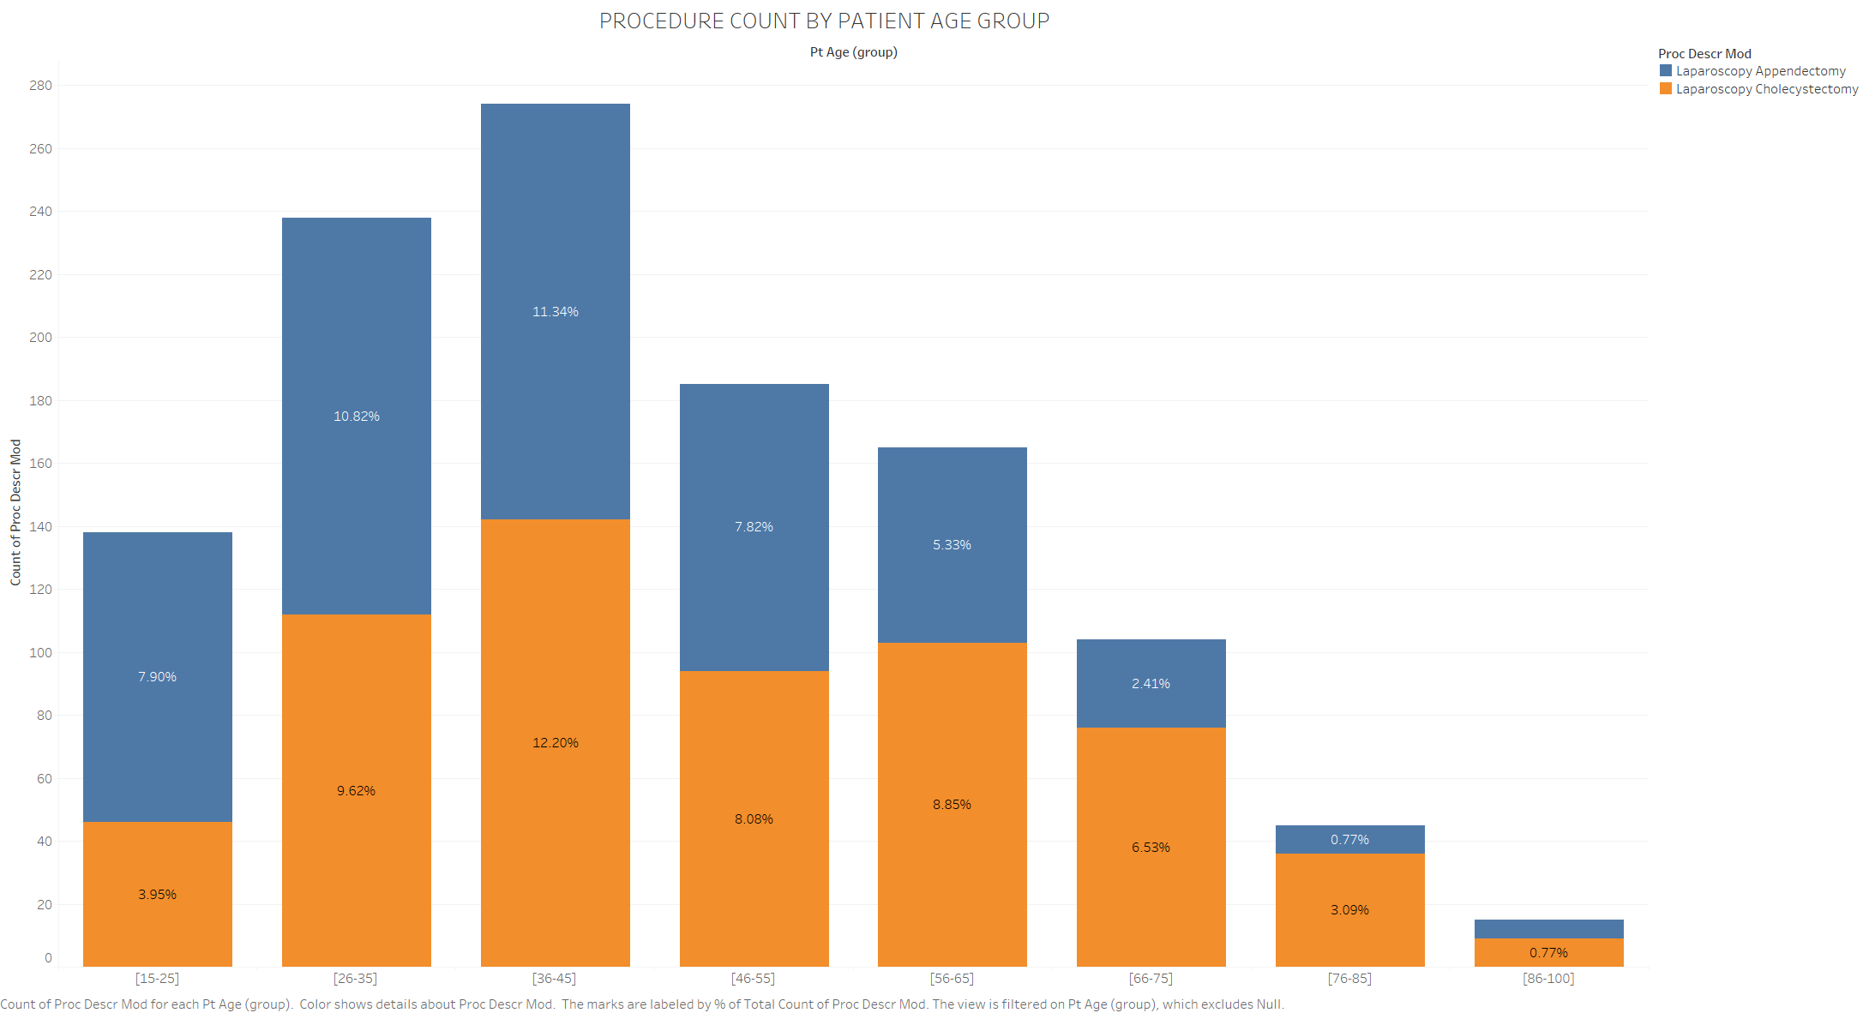
Both procedures were very high in patients within 26 to 45 age groups with after age 75 being the least.

